Slide 1
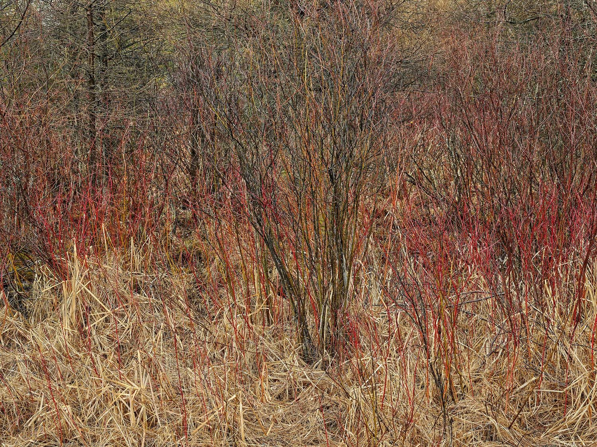

AN INVITATION TO THE RESEARCH COMMUNITY
Climate financial risk has no Linux. We built it.
Climate Risk Commons puts the same enterprise-grade physical climate-risk platform the world's largest banks use into your hands, free for non-commercial work.
Climate Risk Commons
OPEN CLIMATE RISK FRAMEWORK · OCRF V1.0
© Edward Burtynsky, courtesy Nicholas Metivier Gallery, Toronto
Notes:
Recruiting deck for new Climate Risk Commons participants. Founded and funded by RiskThinking.AI.

Slide 2
WHY IT MATTERS
Institutions must report numbers they cannot defend.
Measuring physical climate risk is now a supervised obligation (IFRS S1/S2, CSRD, EU Taxonomy, TCFD, TNFD; EBA, BaFin, FINMA). The harder test is ownership: you cannot defend a methodology you are not permitted to see.
FAILURE 01
FAILURE 02
Numbers you can't defend
Results that don't compare
Methodology sits inside a vendor black box, closed to the regulators, auditors, and boards asking how figures were produced.
Every vendor encodes assets, hazards, and scenarios differently, so similar portfolios diverge and supervisors cannot aggregate.
FAILURE 03
FAILURE 04
A costly door, both ways
Science that keeps restarting
Evaluation takes months and six figures, and proprietary formats make exit expensive, pricing smaller players out.
Without a shared foundation, researchers rebuild the same infrastructure rather than advancing stochastic, multi-hazard methods.

Slide 3
THE STRUCTURAL CURE
The closed model, and how the open standard cures it.
THE CLOSED MODEL IS
THE OPEN STANDARD IS
Black-box methodology you are not permitted to inspect
Inspectable methodology, so you own your models
Assets, hazards, and scenarios encoded differently by every vendor
One shared schema, so results compare across teams and firms
Single-vendor point estimates that manufacture false precision
A stochastic, full-distribution engine that makes uncertainty legible
Cost and expertise walls that shut out smaller institutions and emerging markets
Open, no-cost access for them and the researchers studying them

Slide 4
THROUGH CDTEXPRESS · THE CLIMATE DIGITAL TWIN
Climate 2.0, at planetary scale.
50+
241B
193
All
15
climate hazards modelled
geospatially aligned locations
countries
IPCC emissions scenarios
time horizons to 2100
Stochastic, multi-hazard, coherent across hazards and countries, built for the extreme tail rather than the average case.
Why now: CMIP7. CMIP7 replaces CMIP6, whose data stopped at 2014. The Commons is among the first production systems to ship on it, so you start on the current standard rather than last decade's.

Slide 5
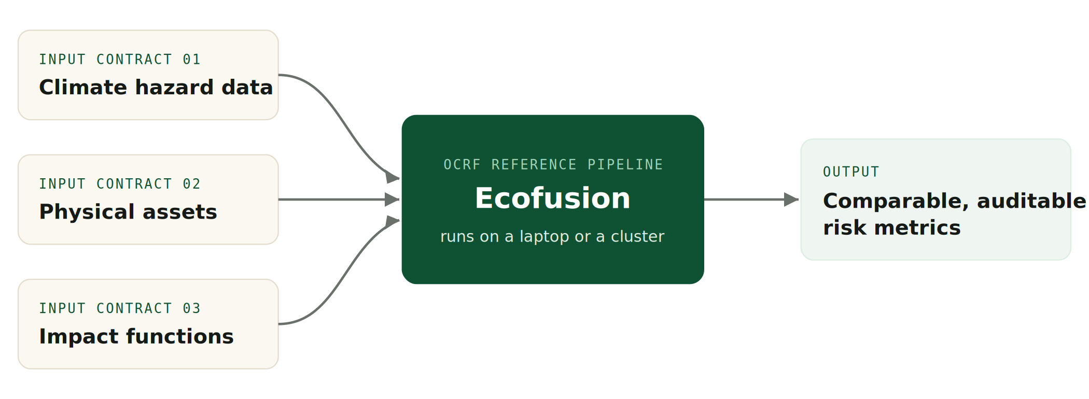
HOW IT WORKS
Three open contracts, one comparable result.
Anyone can run the standard end to end on open reference data. Swap in production-grade inputs when a decision depends on it.

Slide 6
WHAT MEMBERS GET
Eight components, Apache 2.0, no enterprise contract.
01
OCRF spec & asset schema
02
Ecofusion reference pipeline
A common vocabulary for assets and exposure.
End-to-end DataFusion engine, laptop or cluster.
03
Impact-function library
04
SDK & API clients
Validated functions for common asset-hazard pairs.
Permissive Python and R on-ramps to the standard.
05
Sample notebooks
06
Conformance test suite
Portfolio analysis, sensitivity tests, regulatory submissions.
What an implementation must pass, so outputs compare.
07
Documentation
08
Multi-hazard stress testing
Workflows, uncertainty explainers, regulatory mapping.
Exposure to several correlated hazards at once.

Slide 7
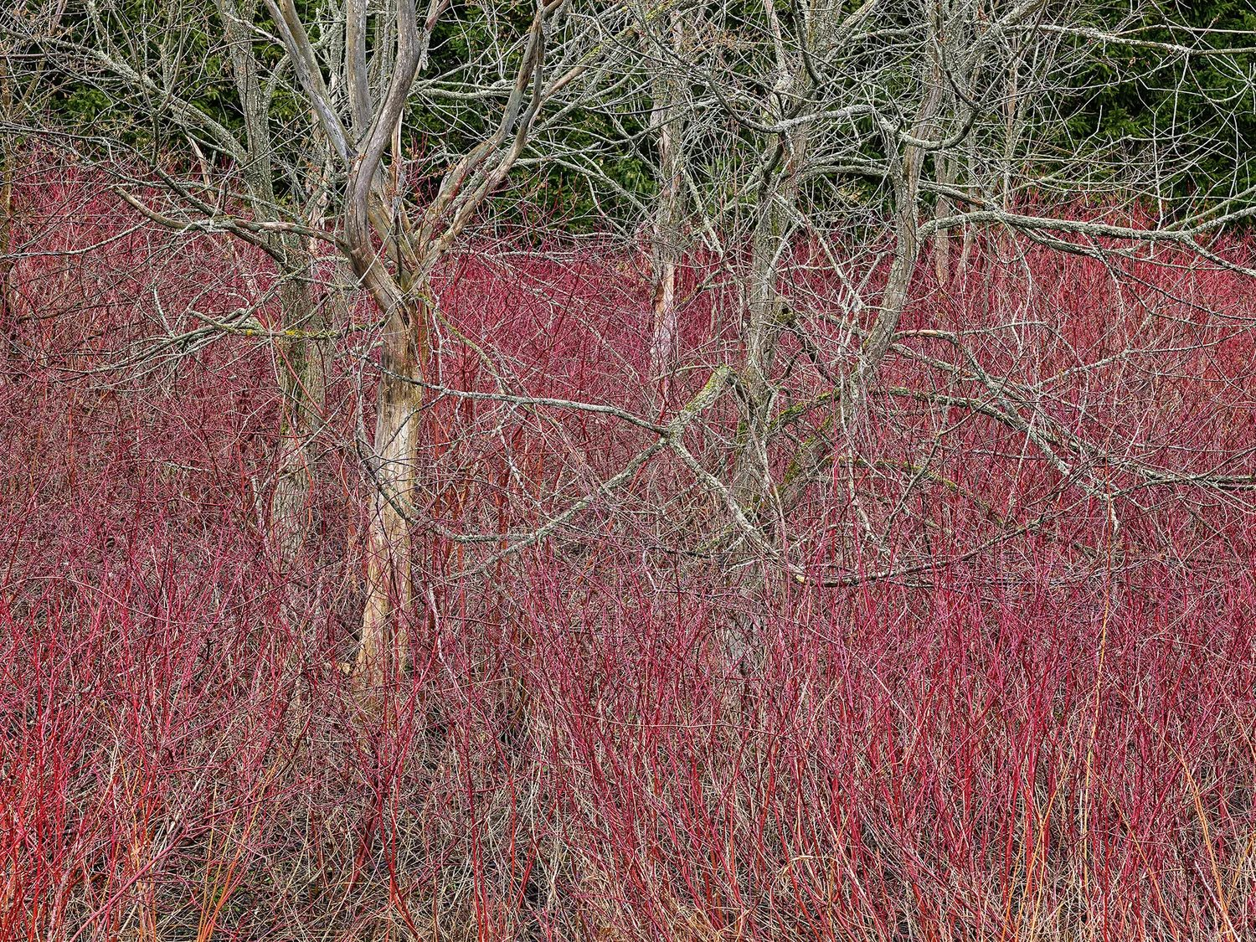
WHAT YOU CAN BUILD
Real questions, answered in an afternoon.
See your real exposure
Load asset or loan-book addresses; the twin geolocates them and returns flood, heat, and wildfire exposure for the assets you actually hold.
Stand up a CMIP7 stress test
Stochastic, multi-pathway, thousands of scenarios, in a structure a supervisor can read and an auditor can follow.
Bring your own data
Your datasets, models, and damage functions still produce results that compare cleanly with everyone else's.
Screen a city or development portfolio
Development banks, ministries, and city networks screen priority risks and share the method.
© Edward Burtynsky, courtesy Nicholas Metivier Gallery, Toronto

Slide 8
CLARITY CUTS BOTH WAYS
What membership is, and what it is not.
MEMBERSHIP IS
MEMBERSHIP IS NOT
The full machinery for calculating physical climate risk, with an environment for open datasets to power it
RiskThinking.AI's proprietary high-fidelity data, reserved for paying customers; its revenue sustains the open platform
The same engine that powers the world's largest financial institutions
A demonstration or teaching edition
Comparability: shared schema, conformance suite, and engine, so teams replicate and compare directly
A dataset play; no single dataset, however good, delivers replication; only a standard does
The Commons is a not-for-profit, founded and funded by RiskThinking.AI, using the same standards as the commercial platform, so open research and commercial practice stay interoperable.

Slide 9
INSTITUTIONS ALREADY ON BOARD
You would be in good company.
The Fields Institute
University of Toronto · Architecture
University of Toronto · Mathematical Finance
Tel Aviv University
Durham University · Finance and Management Science
The Cyprus Academy of Sciences, Letters and Arts
Pacific Institute for Climate Solutions · University of Victoria
Technical University of Munich · CAMBIR
University of Western Ontario · All Science Faculties
London School of Economics · doctoral research
University of Zurich
Queen's University · Smith School of Business · Institute for Sustainable Finance
Central Bank of Brazil
Universidade Federal do Rio Grande do Norte (UFRN)
Stockholm Environment Institute · SEI Latin America
Twintree.Org
University of British Columbia · Sauder School of Business
University of Duisburg-Essen
Jewish Climate Trust

Slide 10
“If this data only serves the institutions that can already afford it, we have not solved the climate-risk problem. We have just priced some people out of knowing it.”
DR. RON DEMBO · CEO AND FOUNDER, RISKTHINKING.AI

Slide 11
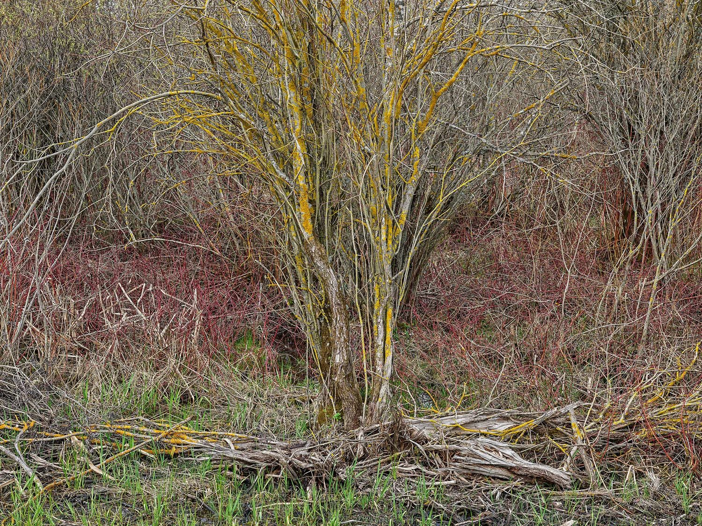
HOW TO JOIN
Membership is free for non-commercial research.
Individual researchers
Apply directly: show proof of your institution and a sentence or two on why you intend to use it.
Faculties and universities
A short letter of intent enrols all your bona fide students, researchers, and faculty at once.
REQUEST ACCESS · academic@riskthinking.ai
© Edward Burtynsky, courtesy Nicholas Metivier Gallery, Toronto

Slide 12
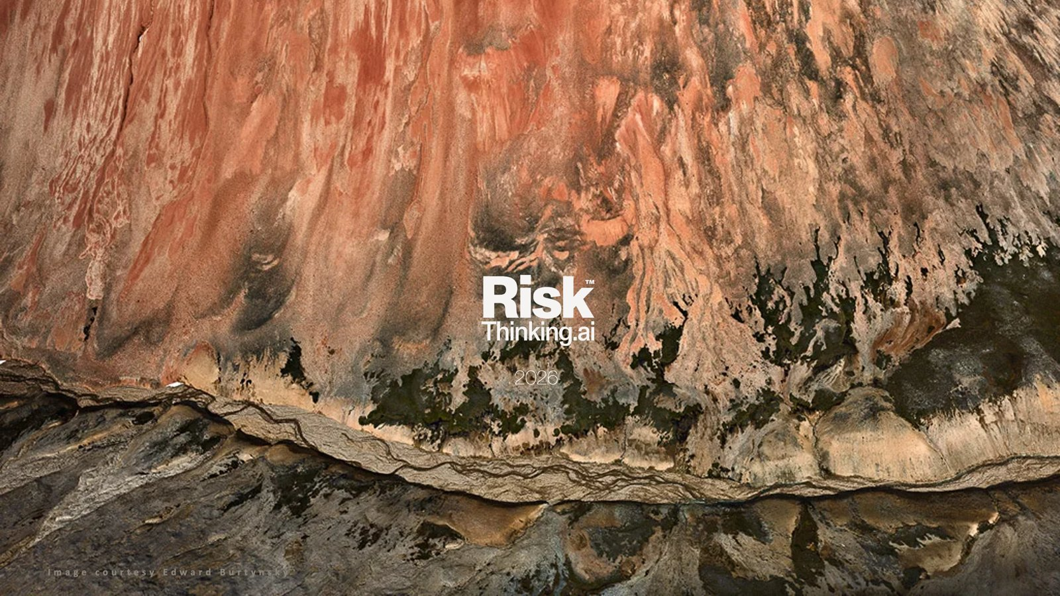
© Edward Burtynsky, courtesy Nicholas Metivier Gallery, Toronto

