Slide 1
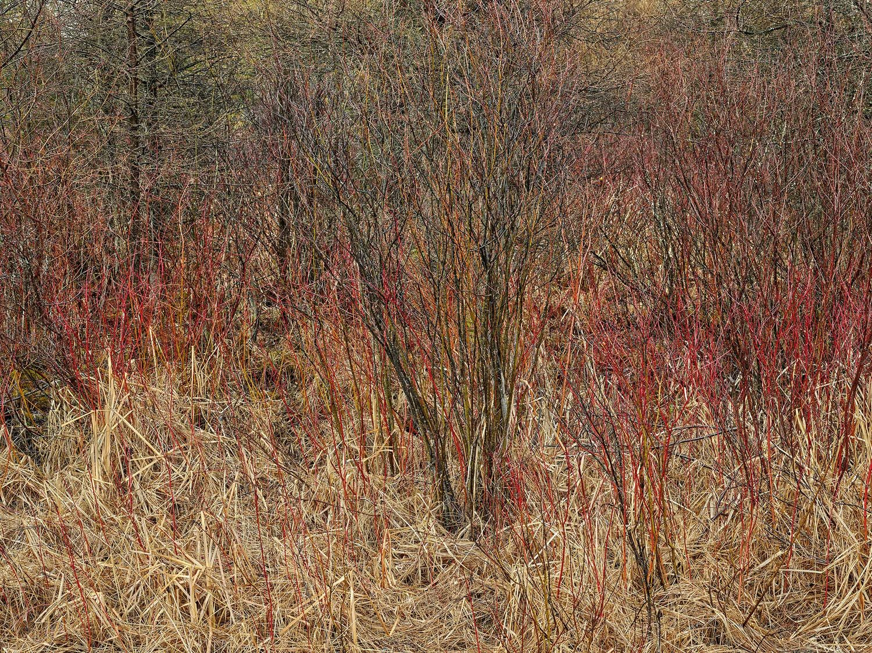

THE COMPLETE PRESENTATION · OCRF V1.0
The Climate Risk Commons
Why we are opening bank-grade climate-risk infrastructure to students, researchers, and the institutions the market forgot.
A not-for-profit, founded and funded by RiskThinking.AI
riskthinking.org
© Edward Burtynsky, courtesy Nicholas Metivier Gallery, Toronto

Slide 2
WHY IT MATTERS
The mandate is now both real and prudential.
Reporting is supervised
IFRS S1 and S2, the CSRD, the EU Taxonomy, TCFD and TNFD have made climate and nature risk a required part of corporate and financial reporting.
Supervisors expect management
Prudential supervisors from the EBA to BaFin and FINMA now expect institutions to identify, measure, manage, and monitor physical climate-risk drivers.
The harder test is ownership
Auditors and supervisors increasingly expect you to understand and own the data and models behind a tool, rather than accept a vendor's black box.
A closed model cannot comply
You cannot defend a methodology you are not permitted to see. A closed, proprietary model cannot meet that bar by design.

Slide 3
FOUR FAILURES OF THE CLOSED MODEL
Institutions must report numbers they cannot defend.
FAILURE 01
FAILURE 02
Numbers you can't defend
Results that don't compare
Methodology sits inside a vendor black box, closed to the regulators, auditors, and boards asking how figures were produced.
Every vendor encodes assets, hazards, and scenarios differently, so similar portfolios diverge and supervisors cannot aggregate.
FAILURE 03
FAILURE 04
A costly door, both ways
Science that keeps restarting
Evaluation takes months and six figures, and proprietary formats make exit expensive, pricing smaller players out.
Without a shared foundation, researchers rebuild the same infrastructure rather than advancing stochastic, multi-hazard methods.

Slide 4
THE STRUCTURAL CURE
An open standard is the structural cure.
THE CLOSED MODEL IS
THE OPEN STANDARD IS
Black-box methodology you are not permitted to inspect
Inspectable methodology, so you own your models
Assets, hazards, and scenarios encoded differently by every vendor
One shared schema, so results compare across teams and firms
Single-vendor point estimates that manufacture false precision
A stochastic, full-distribution engine that makes uncertainty legible
Cost and expertise walls that shut out smaller institutions and emerging markets
Open, no-cost access for them and the researchers studying them

Slide 5
THROUGH CDTEXPRESS · THE CLIMATE DIGITAL TWIN
Climate 2.0, at planetary scale.
50+
241B
193
All
15
climate hazards modelled
geospatially aligned locations
countries
IPCC emissions scenarios
time horizons to 2100
Stochastic, multi-hazard, coherent across hazards and countries, built for the extreme tail rather than the average case.
The timing is decisive: CMIP7. Climate science has just moved to CMIP7, replacing CMIP6 whose data stopped at 2014. The Commons is among the first production systems to ship on it, so members start on the current standard rather than last decade's.

Slide 6
WHAT IT IS
An open standard, anchored by two pieces.
OCRF
The Open Climate Risk Framework defines the shared contracts, asset schema, reference pipeline, APIs, SDKs, and tooling that let hazards, assets, and impact functions interoperate.
Ecofusion
The reference pipeline runs the entire specification end to end on a laptop or a cluster using open reference data. Every component is licensed under Apache 2.0, with terms you can hand to your legal office.
CDTexpress
Through CDTexpress, members reach the full Climate Digital Twin engine behind it, the same computational core used in regulatory scenario exercises and institutional analytics.
This is Climate 2.0: stochastic, multi-hazard, coherent across hazards and countries, and built for the extreme tail rather than the average case.

Slide 7
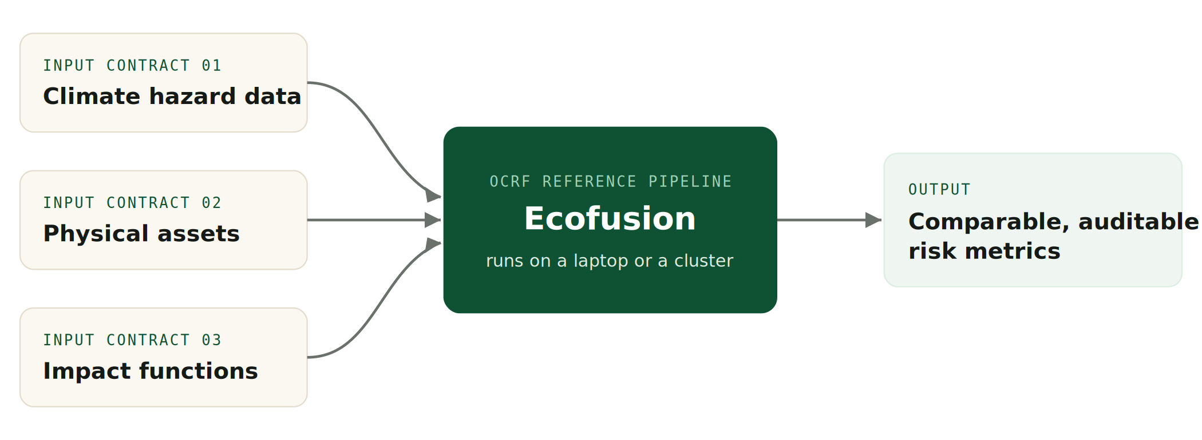
HOW IT WORKS
Three open contracts, one comparable result.
Anyone can run the standard end to end on open reference data. Swap in production-grade inputs when a decision depends on it.

Slide 8
WHAT MEMBERS GET
Eight components, Apache 2.0, no enterprise contract.
01
OCRF spec & asset schema
02
Ecofusion reference pipeline
A common vocabulary for assets and exposure.
End-to-end DataFusion engine, laptop or cluster.
03
Impact-function library
04
SDK & API clients
Validated functions for common asset-hazard pairs.
Permissive Python and R on-ramps to the standard.
05
Sample notebooks
06
Conformance test suite
Portfolio analysis, sensitivity tests, regulatory submissions.
What an implementation must pass, so outputs compare.
07
Documentation
08
Multi-hazard stress testing
Workflows, uncertainty explainers, regulatory mapping.
Exposure to several correlated hazards at once.

Slide 9
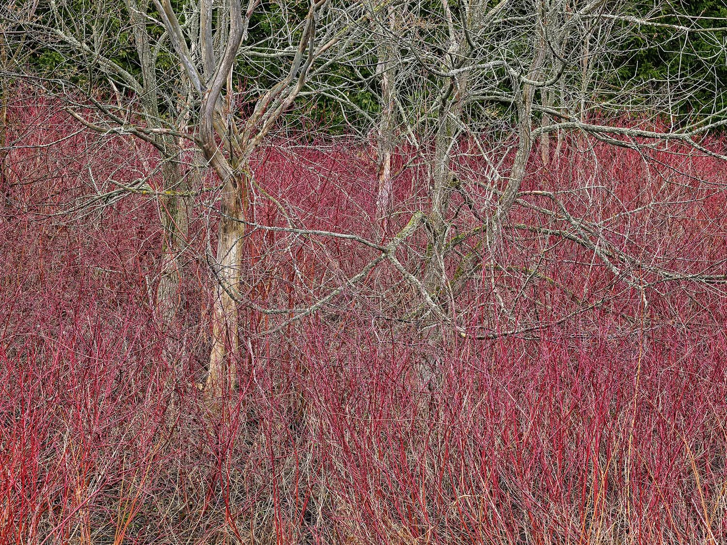
WHAT YOU CAN BUILD
Real questions, answered in an afternoon.
See your real exposure
Load asset or loan-book addresses; the twin geolocates them and returns flood, heat, and wildfire exposure for the assets you actually hold.
Stand up a CMIP7 stress test
Stochastic, multi-pathway, thousands of scenarios, in a structure a supervisor can read and an auditor can follow.
Bring your own data
Your datasets, models, and damage functions still produce results that compare cleanly with everyone else's.
Screen a city or development portfolio
Development banks, ministries, and city networks screen priority risks and share the method.
© Edward Burtynsky, courtesy Nicholas Metivier Gallery, Toronto

Slide 10
CLARITY CUTS BOTH WAYS
What membership is, and what it is not.
MEMBERSHIP IS
MEMBERSHIP IS NOT
The full machinery for calculating physical climate risk, with an environment for open datasets to power it
RiskThinking.AI's proprietary high-fidelity data, reserved for paying customers; its revenue sustains the open platform
The same engine that powers the world's largest financial institutions
A demonstration or teaching edition
Comparability: shared schema, conformance suite, and engine, so teams replicate and compare directly
A dataset play; no single dataset, however good, delivers replication; only a standard does
The Commons is a not-for-profit, founded and funded by RiskThinking.AI, using the same standards as the commercial platform, so open research and commercial practice stay interoperable.

Slide 11
IN PLAIN TERMS · 1 OF 2
The boundary, in plain terms.
Q Do members get RiskThinking.AI's commercial data?
No. The high-fidelity data is reserved for paying customers. Members get the machinery and an environment stocked with open datasets. What differs is the data flowing through it, not the machinery doing the work.
Q Is the engine the same one commercial clients use?
Yes. The Commons runs on the same engine that powers the world's largest institutions. Nothing in the Commons is a demonstration version.
Q What data can members use?
The open reference datasets in the Commons environment, any open dataset members upload, and any data, models, or damage functions of their own. Results remain conformant regardless of whose data powers them.
Q Are results on open data scientifically credible?
Yes. The engine, schema, and conformance suite are identical to the commercial stack. Precision depends on data resolution, and members should report that, exactly as good science already requires.

Slide 12
IN PLAIN TERMS · 2 OF 2
The boundary, in plain terms.
Q Why open the machinery but not the data?
The field's structural problem is the absence of a shared standard, not a shortage of datasets. Opening the machinery fixes comparability for everyone; commercial data revenue sustains the open platform.
Q Who owns and runs the Commons?
A not-for-profit, founded and funded by RiskThinking.AI. RiskThinking is the standard's first maintainer, not its owner; as adoption grows, a neutral foundation follows.
Q What if a member later needs high-fidelity data?
That is a commercial conversation, and we are happy to have it. Write to academic@riskthinking.ai and we will route it to the right team.
Q Can membership be used for commercial work?
No. Membership is free for non-commercial research only. Commercial use of the platform or of RiskThinking.AI's data requires a commercial licence.

Slide 13
THE ECOSYSTEM
What we are looking for partners to build.
Conforming data products
Impact functions
Hazard, asset, and exposure data published against the OCRF input contracts, including from providers who compete with RiskThinking.AI.
Sector-, peril-, and region-specific damage functions, contributed to the open library or offered commercially against the spec.
Integrations & connectors
Implementations & tooling
Bridges into risk platforms, portfolio systems, GIS tools, reporting workflows, and cloud data platforms.
Alternative pipelines, validation and conformance tools, benchmarking suites, and developer utilities.
Research & methods
Applications
Work that tests, extends, and improves the methods encoded in the spec, published so others can reproduce it.
Decision tools for underwriting, lending, asset management, supply chain, infrastructure planning, and regulatory reporting.

Slide 14
BUILDING IN THE ECOSYSTEM
From clone to shipped, in six steps.
1
Orient
2
Pick your surface
Read the OCRF spec and the three input contracts. Clone Ecofusion and run it end to end on the reference data: a day or two to a working mental model.
Data providers publish against an input contract; modelers contribute or sell impact functions; tool builders consume outputs; implementers build pipelines.
3
Build against the contracts
4
Validate conformance
The reference pipeline and open data are your test harness: if it works with Ecofusion on reference data, it works with the ecosystem.
Conformance makes your product plug-compatible with everything else, and it's the claim you put in front of customers.
5
Contribute back
6
Ship and distribute
Fixes, tooling, docs, and open impact functions flow through the published contribution process, earning a voice in the roadmap.
The standard is your distribution: every OCRF adopter is a prospective user of every conforming component.

Slide 15
WHO BENEFITS
Researchers and developers both win.
RESEARCHERS & ACADEMICS
DEVELOPERS & IMPLEMENTERS
Reproducibility by default. Methods published against OCRF re-run by anyone, on open data, in an open pipeline.
A path from paper to practice. Contributed methods get adopted by practitioners.
Shared infrastructure. Spec, pipeline, and data remove months of setup, so effort goes into the science.
Influence on the standard. Early researchers shape how v1 encodes hazards, exposure, and vulnerability.
A stable foundation. Open contracts and versioned specs mean a vendor API change won't strand your work.
Distribution through the standard. Every OCRF adopter is a prospective user of conforming tools.
Zero-friction start. Pipeline, sample data, SDKs, and docs are free, so evaluation costs an afternoon, not a procurement cycle.
Community and visibility. Recognition in a growing ecosystem and a voice in the roadmap.

Slide 16
A MOVEMENT, NOT A RELEASE
Governance built to outlast us.
Extend the frontier the market has skipped
The underserved long tail, agriculture and supply chains, real estate and unlisted assets, single river basins, specific hazards and geographies, is exactly where researchers work. Researchers pressure-test a standard, validate it, and extend it, giving it a legitimacy no single vendor's marketing can buy.
Shape something built to outlast any vendor
RiskThinking is the first maintainer of the standard, not its owner. As adoption grows, a neutral foundation follows, so what members build on remains in place in five years.
Neutrality you can verify
Governance is lightweight but real: clear spec versioning, a published contribution process, reference implementations, and a public roadmap. Competing providers are explicitly welcome to conform and contribute.

Slide 17
ROADMAP
Four phases, honestly hedged.
1
2
3
4
Groundwork
Ecosystem ignition
Standard expansion
Scale and sustain
Resolve the patent-rights path, select the licence, prepare the repository, finalize spec v1, onboard pilot users.
Public release of Ecofusion, OCRF, and the schema; the open tier goes live; design partners join.
Community contributions, academic partners, deeper regulatory engagement, transition to a neutral foundation.
Premium data, support, and advanced capabilities sustain the open core for everyone building on it.
Expect rough edges. Specs, APIs, and data schemas may change during the preview, sometimes with little notice. Availability is a plan, not a promise; the exact order and timing of drops may shift.

Slide 18
INSTITUTIONS ALREADY ON BOARD
You would be in good company.
The Fields Institute
University of Toronto · Architecture
University of Toronto · Mathematical Finance
Tel Aviv University
Durham University · Finance and Management Science
The Cyprus Academy of Sciences, Letters and Arts
Pacific Institute for Climate Solutions · University of Victoria
Technical University of Munich · CAMBIR
University of Western Ontario · All Science Faculties
London School of Economics · doctoral research
University of Zurich
Queen's University · Smith School of Business · Institute for Sustainable Finance
Central Bank of Brazil
Universidade Federal do Rio Grande do Norte (UFRN)
Stockholm Environment Institute · SEI Latin America
Twintree.Org
University of British Columbia · Sauder School of Business
University of Duisburg-Essen
Jewish Climate Trust

Slide 19
“If this data only serves the institutions that can already afford it, we have not solved the climate-risk problem. We have just priced some people out of knowing it.”
DR. RON DEMBO · CEO AND FOUNDER, RISKTHINKING.AI

Slide 20
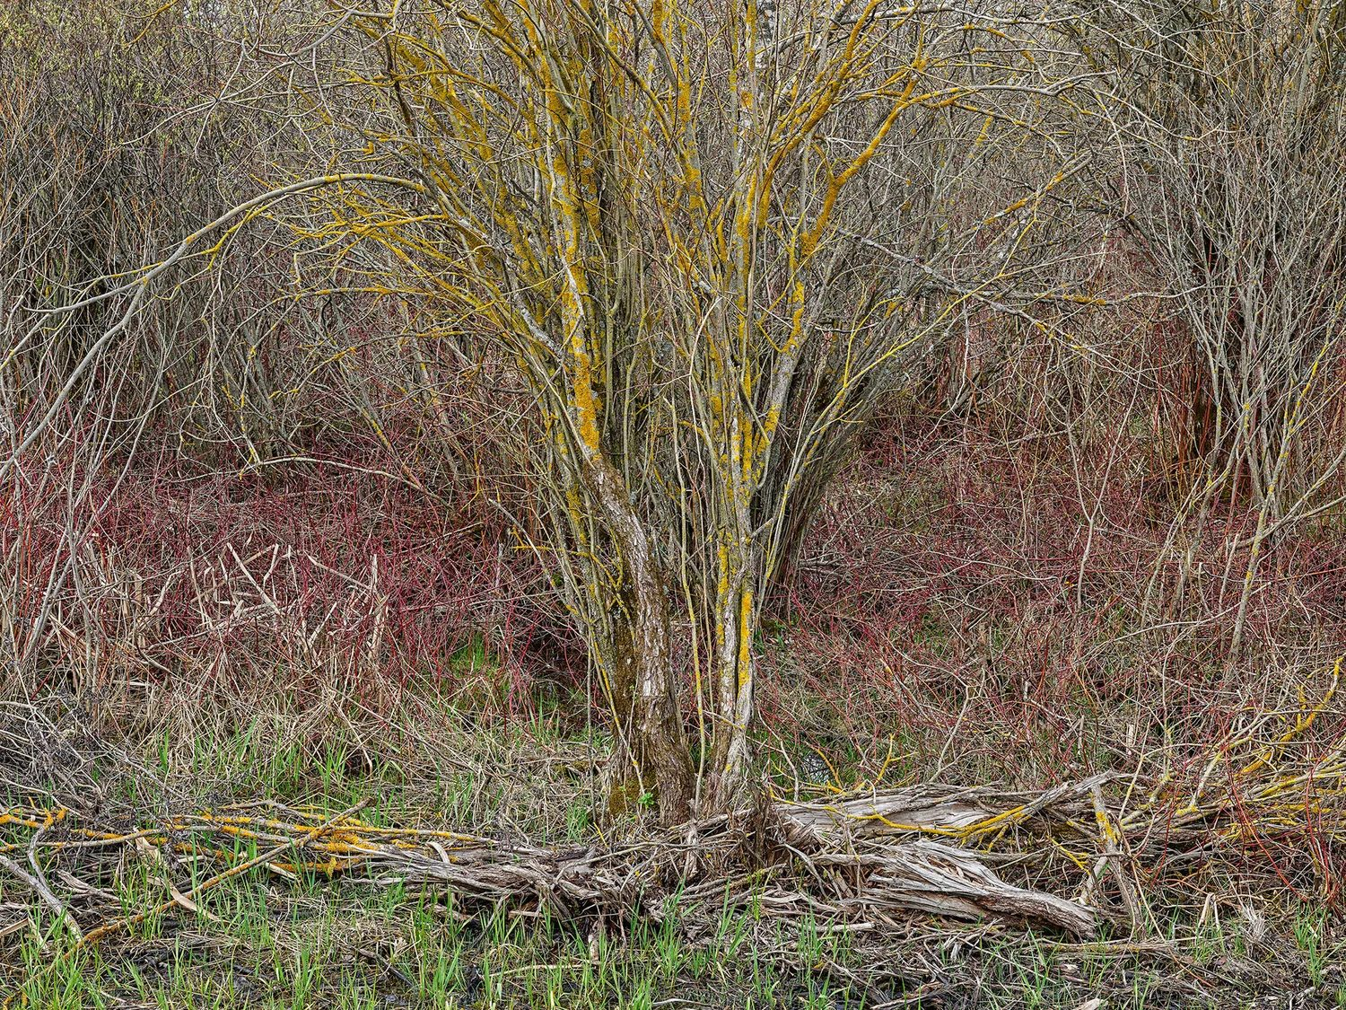
HOW TO JOIN
Membership is free for non-commercial research.
Individual researchers
Apply directly: show proof of your institution and a sentence or two on why you intend to use it.
Faculties and universities
A short letter of intent enrols all your bona fide students, researchers, and faculty at once.
REQUEST ACCESS · academic@riskthinking.ai · riskthinking.org
© Edward Burtynsky, courtesy Nicholas Metivier Gallery, Toronto

Slide 21

© Edward Burtynsky, courtesy Nicholas Metivier Gallery, Toronto

